Slide 1

Vincenzo Passannante¹
CORSO DI DOTTORATO IN
INGEGNERIA ED ECONOMIA DELL’INNOVAZIONE
XIII CICLO
¹Department of Economics and Statistics, University of Salerno, Italy
Theoretical problems in Cause – Specific Mortality forecasting and diagnosis rates.
Solutions and actuarial applications.
March 5, 2015 University of Salerno

Slide 2
Agenda
Motivation
Modelling of cause-specific mortality
Mitigating the discontinuities
About the dependence
Critical Illness Cover
New proposal for Insured Loan
Case study
Conclusions

Slide 3
Motivation
New horizons for Insured Loan
CUSTOMIZING INSURANCE AND FINANCIAL PRODUCTS
INCREASING AVAILABILITY OF SPECIFIC DATA
LONGEVITY RISK

Slide 4
The IDEA is to insert other type of insurance coverage in the financial management
Cause – specific
death
Critical Illness

Slide 5
Modelling of cause-specific mortality
Structural Breaks and Dependence
Forecasting the future trend of cause –specific mortality
Mitigate the discontinuity points
Consider the dependence

Slide 6
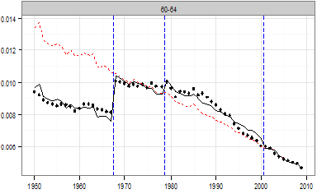
The problem of prediction for causes of death
International Classification of Diseases (ICD), dependence
  Discontinuities in the time series
  Dependences among the cause – specific deaths/diseases
Important implications on several Insured Loan Proposed
  Better estimates and predictions of cause-specific mortality
  New tools for Insurance Company
Central death rate for Circulatory System
(age 60-64, female)
year
year
year

Slide 7
Mitigating the discontinuties
The Model of Haberman et al. (2014)
Average age-specific mortality
Deviation in mortality
Mortality index at year t
Adjustment for coding changes
Constraints:
Assumption:
where:

Slide 8
About the dependence
Vector Error Correction Model
Selection the lag order of VAR(p)
Akaike’s Information Criteria (AIC), Hannan-Quinn Criterion (HQ), Schwarz Criterion (SC), Final Prediction Error (FPE).
Unit root test
With some tests (KPSS, ADF, PP) it is possible to see if the characteristic polynomial has unit root. KPSS tests the null hypothesis that the variable is trend stationary, while ADF and PP test the null hypothesis of a unit root (the null hypothesis of non-stationary).

Slide 9
Vector Error Correction Model
Fitting a VAR(p) or VECM
If all the variables are stationary (I(O), integrated of zero order) the fitting with a VAR is appropriate. However, the Johansen’s procedure should be applied if some of the variables are I(1) in order to find the number of cointegrating relations. With the trace test and the maximum eigenvalue test we can see the number of cointegrating relations. If there isn’t cointegration between the variables it is possible to use a VAR (p-1) on the first difference.

Slide 10
VAR and VECM for Kt
Consider VAR(p)
with:
The condition for the Var(p) model to be stationary is:
for
for

Slide 11
VAR and VECM for Kt
Unit root tests
All causes of death have unit roots
NOT STATIONARY
ALL VARIABLES ARE I(1)

Slide 12
Cointegration
If all the variables aren’t stationary and integrated of the same order, we can find an equilibrium between them in the long – run represented by this equation:

Slide 13
Cointegration
If this relation is stationary (it means that they have the same trend in the long – run), the variables are cointegrated.
If the process is stationary
ALL CAUSES OF DEATH ARE COINTEGRATED

Slide 14
How many cointegrating relation are there?
Consider a process with three variables integrated of order 1, and suppose that it is cointegrated with the cointegrated vector , ,such that
It is shown, with the Granger representation theorem, that if the series are cointegrated, exists a representation ECM.

Slide 15
How many cointegrating relations?

Slide 16
How many cointegrating relations?
In matrix form:
Representation of the VAR(2) in the form vector error correction model (multivariate version of the Dickey – Fuller test)
Matrix Loading
Coint. Matrix

Slide 17
How many cointegrating relations?
We can determinate the number of cointegrating relations in the series Yt by the rank of the matrix . In particular:
if the is a VAR(p-1) stationary;
if the has not unit roots, it is a VAR(p) stationary;
if has r cointegrating relations and k-r common trend.

Slide 18
Critical Illness Cover
Stand Alone and Accelerated Benefit
Stand Alone Cover
  A benefit is paid if the assured suffers for one the following contractual critical conditions ( for example Heart Attack, Stroke, Cancer, Respiratory System).
Accelerated benefit
  Stand Alone + accelerated benefit if the assured dies. A benefit is paid if the assured suffers a particular diseases and an accelerated benefit in case of death.

Slide 19
Insured Loan
SIL: Standard Insured Loan
Supposing the borrower/insured’s debt is one monetary unit
where

Slide 20
The benefit payable if the insured dies
The constant actuarial premium the insured pays if alive
in which

Slide 21
New proposals for Insured Loan
SpeIL: Death Specific Insured Loan
The basic equation is:
  - The idea is to design a product in which the loan is saved in case of the borrower’s death for a specific cause.

Slide 22
SCILsa: Standard Critical Illness Loan (Stand Alone)
  - In this case the loan is saved if the insured suffers specified critical diseases.

Slide 23
SCILa: Standard Critical Illness Loan (Accelerated)
  - in which is the probability of the two compatible events, specifically to die for any cause of death and/or to suffer a specified illness.

Slide 24
Case study
Application to the U.K. case
Population data
  U.K. Population (diff. cohort)
  Ages: 25-29,30-34,…,84-89
  Period: 1950-2001
CMI: disease rates
HMD: aggregated m.r.
WHO: death-cause m.r.
Loan Characteristics
  Duration: 10/20 years
  Interest rate = 7%, Issue Time = 2014, C = 200000 euro
Insurance Cover Characteristics
  SIL, SpeIL, SCILsa, SCILa
  Technical actuarial valuation rate = 2%
  Age at entry = 40/60

Slide 25
Mitigating the discontinuities in the mortality time series with an extension of the Lee – Carter Model.
Capturing the possible dependences among the cause – specific deaths.
Forecasting them trough the ARIMA models, the VECM (only if there are several stationary cointegrating relations between them) and the Vector Autoregressive Model (if their representation has not unit roots).
Use the better prevision in order to calculate the future trend of mortality rates.
Finally, the pricing our proposed contracts.

Slide 26
Parameters estimation
Figure 1:
Model parameters (Circulatory System, UK Male population)

Slide 27
Adjusted Kt
Figure 2:
Adjusted mortality index (Circulatory System, UK Male population)

Slide 28
SELECT LAG ORDER
Select lag order VAR(p)
U.K. Male Population U.K. Female Population
AIC(n) | HQ(n) | SC(n) | FPE(n)
2 | 1 | 1 | 1
AIC(n) | HQ(n) | SC(n) | FPE(n)
1 | 1 | 1 | 1
  - The eigenvalues are bigger than one in absolute value. This means that the VAR could be explode because its characteristic polynomial has unit roots.

Slide 29
UNIT ROOT TESTS: ADF (MALE)
CAUSES OF DEATH | ADF | P - VALUE
I&P | -0.9381 | 0,9402
Cancer | -0.4784 | 0,9798
Circulatory System | 2.0119 | 0,99
Respiratory System | -2.33 | 0,4414
External | -1.2111 | 0,8936
Other | -1.0549 | 0,9219
CAUSES OF DEATH | PP | P - VALUE
I&P | -1.7203 | 0,9737
Cancer | -0.2694 | 0,99
Circulatory System | 1.2455 | 0,99
Respiratory System | -38.1031 | 0,01
External | -7.3597 | 0,6793
Other | -2.5195 | 0,9523
CAUSES OF DEATH | KPSS | P - VALUE
I&P | 2.3031 | 0,01
Cancer | 1.163 | 0,01
Circulatory System | 2.6937 | 0,01
Respiratory System | 3.0345 | 0,01
External | 3.0138 | 0,01
Other | 2.4834 | 0,01

Slide 30
UNIT ROOT TESTS: ADF (FEMALE)
CAUSES OF DEATH | ADF | P - VALUE
I&P | -2.8242 | 0,2416
Cancer | 0.1599 | 0,99
Circulatory System | 1.0873 | 0,99
Respiratory System | -4.6381 | 0,01
External | -2.1588 | 0,5106
Other | -1.0109 | 0,9288
CAUSES OF DEATH | PP | P - VALUE
I&P | -7.5514 | 0,6677
Cancer | 1.362 | 0,99
Circulatory System | 1.3336 | 0,99
Respiratory System | -74.9722 | 0,01
External | -5.8541 | 0,7705
Other | -2.6035 | 0,95
CAUSES OF DEATH | KPSS | P - VALUE
I&P | 2.7215 | 0,01
Cancer | 0.5891 | 0.02363
Circulatory System | 2.9883 | 0,01
Respiratory System | 2.1376 | 0,01
External | 2.9435 | 0,01
Other | 1.5903 | 0,01

Slide 31
Kt First difference, Male

Slide 32
Kt First difference, Female

Slide 33
Trace Test, Maximum Eigenvalue Test
MALE
h | n-h | stat | 10% | 5% | 2.5% | 1%
4 | 1 | 0.05041928 | 2.70 | 3.84 | 5.25 | 6.98
3 | 2 | 6.18016087 | 15.74 | 18.08 | 20.26 | 22.40
2 | 3 | 24.83020039 | 31.67 | 34.27 | 36.98 | 40.10
1 | 4 | 51.09236539 | 50.62 | 54.02 | 57.01 | 61.03
0 | 5 | 96.15921357 | 73.73 | 77.61 | 81.29 | 85.56
h | n-h | stat | 10% | 5% | 2.5% | 1%
4 | 1 | 0.05041928 | 2.70 | 3.84 | 5.25 | 6.98
3 | 2 | 6.12974159 | 14.64 | 16.69 | 18.84 | 20.88
2 | 3 | 18.65003953 | 21.44 | 23.75 | 25.68 | 28.31
1 | 4 | 26.26216499 | 27.39 | 29.93 | 32.22 | 35.57
0 | 5 | 45.06684818 | 33.45 | 36.46 | 39.00 | 41.87

Slide 34
Trace Test, Maximum Eigenvalue Test
FEMALE
h | n-h | stat | 10% | 5% | 2.5% | 1%
4 | 1 | 0.2883353 | 2.70 | 3.84 | 5.25 | 6.98
3 | 2 | 9.5286355 | 15.74 | 18.08 | 20.26 | 22.40
2 | 3 | 39.2167916 | 31.67 | 34.27 | 36.98 | 40.10
1 | 4 | 83.8383564 | 50.62 | 54.02 | 57.01 | 61.03
0 | 5 | 155.0295236 | 73.73 | 77.61 | 81.29 | 85.56
h | n-h | stat | 10% | 5% | 2.5% | 1%
4 | 1 | 0.2883353 | 2.70 | 3.84 | 5.25 | 6.98
3 | 2 | 9.2403001 | 14.64 | 16.69 | 18.84 | 20.88
2 | 3 | 29.6881561 | 21.44 | 23.75 | 25.68 | 28.31
1 | 4 | 44.6215648 | 27.39 | 29.93 | 32.22 | 35.57
0 | 5 | 71.1911673 | 33.45 | 36.46 | 39.00 | 41.87

Slide 35
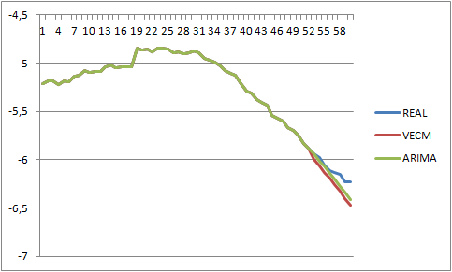
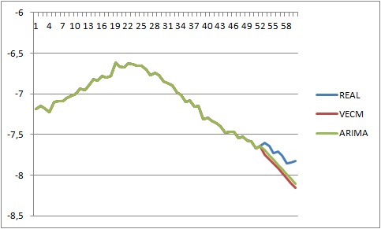
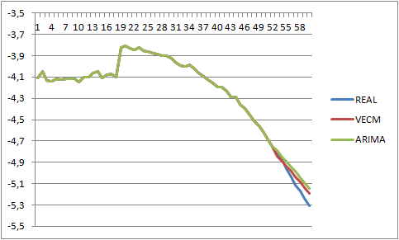
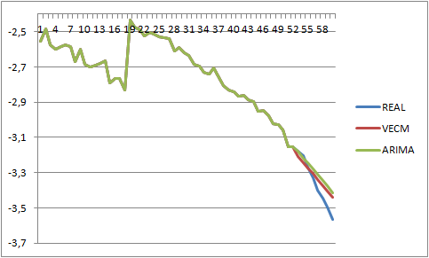
Forecast VECM and ARIMA
40-44
50-54
70-74
80-84

Slide 36
MAPE
MALE
 | VECM | ARIMA
2002 | 1,32% | 0,72%
2003 | 1,40% | 1,03%
2004 | 1,55% | 1,42%
2005 | 1,78% | 1,72%
2006 | 2,43% | 2,46%
2007 | 2,53% | 2,55%
2008 | 3,17% | 3,21%
2009 | 3,30% | 3,35%
FEMALE
 | VECM | ARIMA
2002 | 1,08% | 0,76%
2003 | 1,63% | 1,31%
2004 | 1,44% | 1,47%
2005 | 1,74% | 1,83%
2006 | 1,84% | 2,04%
2007 | 2,17% | 2,31%
2008 | 2,40% | 2,42%
2009 | 2,85% | 2,93%

Slide 37
Table 1. Actuarial Periodic Premium – Female. Issue Time 2014, r = 2%, i = 7%, C = 200.000
Table 1.a Standard Insured Loan – SIL Table 1.b Specific Insured Loan – SpeIL
Age at entry/Duration | 40 | 60
10 | 90,19 | 749,04
20 | 175,95 | 1.320,07
Age at entry/Duration | 40 | 60
10 | 62,65 | 532,64
20 | 120,72 | 981,14
Table 2. Actuarial Periodic Premium Table 3. Actuarial Periodic Premium
Female non-smokers. Issue Time 2014, r = 2%, i = 7%, C = 200.000 Female smokers. Issue Time 2014, r = 2%, i = 7%, C = 200.000
Table 2.a Stand. C. I. Loan Table 2.b Standard C.I. Loan Table 3.a Stand. C. I. Loan Table 3.b Standard C.I. Loan
(Stand Alone)- SCILsa (Accelerated) – SCILa (Stand Alone)- SCILsa (Accelerated) – SCILa
Age at ent./ Duration | 40 | 60
10 | 262,4 | 831,4
20 | 422,3 | 1198,6
Age at ent./ Duration | 40 | 60
10 | 285,62 | 925,37
20 | 456,98 | 1424,2
Age at ent./ Duration | 40 | 60
10 | 213,8 | 805
20 | 273,2 | 925,8
Age at ent./ Duration | 40 | 60
10 | 352,21 | 1304,3
20 | 580,7 | 2034,17

Slide 38
Table 1. Actuarial Periodic Premium – Male. Issue Time 2014, r = 2%, i = 7%, C = 200.000
Table 1.a Standard Insured Loan – SIL Table 1.b Specific Insured Loan – SpeIL
Age at entry/Duration | 40 | 60
10 | 108,23 | 1.251,55
20 | 231,06 | 2.106,08
Age at entry/Duration | 40 | 60
10 | 64,87 | 746,67
20 | 129,59 | 1.440,78
Table 2. Actuarial Periodic Premium Table 3. Actuarial Periodic Premium
Male non-smokers. Issue Time 2014, r = 2%, i = 7%, C = 200.000 Male smokers. Issue Time 2014, r = 2%, i = 7%, C = 200.000
Table 2.a Stand. C. I. Loan Table 2.b Standard C.I. Loan Table 3.a Stand. C. I. Loan Table 3.b Standard C.I. Loan
(Stand Alone)- SCILsa (Accelerated) – SCILa (Stand Alone)- SCILsa (Accelerated) – SCILa
Age at ent./ Duration | 40 | 60
10 | 218,7 | 1339,6
20 | 429,7 | 2049,7
Age at ent./ Duration | 40 | 60
10 | 260,27 | 1515,2
20 | 498,18 | 2373,1
Age at ent./ Duration | 40 | 60
10 | 440,6 | 2378
20 | 834,2 | 3590,5
Age at ent./ Duration | 40 | 60
10 | 547,7 | 2975
20 | 1035,2 | 4686,7

Slide 39
Amortization Schedule
Table 7.a. Amortization Schedule. Table 7.a. Amortization Schedule.
Issue Time 2014, r = 7%, C = 200.000, n = 10 Issue Time 2014, r = 7%, C = 200.000, n = 20
Mat. | Financial Instalment | Payment due in case of insolvency
1 | 28.475.50 | 214.000,00
2 | 28.475,50 | 198.511,21
3 | 28.475,50 | 181.938,21
4 | 28.475,50 | 164.205,10
5 | 28.475,50 | 145.230,66
6 | 28.475,50 | 124.928,02
7 | 28.475,50 | 103.204,22
8 | 28.475,50 | 79.959,72
9 | 28.475,50 | 55.088,10
10 | 28.475,50 | 28.475,49
Mat. | Financial Instalment | Payment due in case of insolvency | Maturity | Financial Instalment | Payment due in case of insolvency
1 | 18.878,59 | 214.000,00 | 11 | 18.878,59 | 141.876,95
2 | 18.878,59 | 208.779,91 | 12 | 18.878,59 | 131.608,26
3 | 18.878,59 | 203.194,41 | 13 | 18.878,59 | 120.620,75
4 | 18.878,59 | 197.217,95 | 14 | 18.878,59 | 108.864,10
5 | 18.878,59 | 190.823,10 | 15 | 18.878,59 | 96.284,51
6 | 18.878,59 | 183.980,65 | 16 | 18.878,59 | 82.824,33
7 | 18.878,59 | 176.659,19 | 17 | 18.878,59 | 68.421,95
8 | 18.878,59 | 168.825,25 | 18 | 18.878,59 | 53.011,41
9 | 18.878,59 | 160.442,95 | 19 | 18.878,59 | 36.961,41
10 | 18.878,59 | 151.473,85 | 20 | 18.878,59 | 18.878,59

Slide 40
Global Installment
Table 8.a. Global annual obligation. Table 8.b. Global annual obligation.
Standard C.I. Loan (Accelerated) – SCILa Standard Insured Loan – SIL
Female non smokers, C=200000, i=7%, r=2% Female non smokers, C=200000, i=7%, r=2%
Age at entry/ Duration | 40 | 60
10 | 28761.12 | 29400.87
20 | 19335.57 | 20302.75
Age at entry/ Duration | 40 | 60
10 | 28565.69 | 29224.54
20 | 19054.54 | 20198.66
Table 8.c Global annual obligation. Table 8.c Global annual obligation.
Specific C.I. Loan (Accelerated)- SCILsa Specific Insured Loan – SpeIL
Female non smokers, C=200000, i=7%, r=2% Female, C=200000, i=7%, r=2%
Age at entry/ Duration | 40 | 60
10 | 28738.88 | 29307.03
20 | 19300.87 | 20077.33
Age at entry/ Duration | 40 | 60
10 | 28538.15 | 29008.14
20 | 18999.31 | 19859.73

Slide 41
Conclusions
The causes of death are competing risk, a dependence exists between them.
We introduce a new method to better understand the dependence between all causes of death, also mitigating the discontinuity points.
We can propose tailored contract modelling the cause – specific deaths.

Slide 42
Vincenzo Passannante
Department of Economics and Statistics, University of Salerno vpassannante@unisa.it
Thanks for your attention

